Slide 1
Protein-Ligand Interaction Classification Using Machine Learning Models
Group 12: Jiacheng Zu, Zhongzheng Mao, Wei Feng Siew, Xinyi Guo, Shuangrui Chen

Slide 2
OUTLINE
Introduction
Dataset
Workflow
Literature Review
Problems met
Model-1
Model-2
Discussion
Conclusion

Slide 3
Introduction
Protein-Ligand Interactions: Essential for processes such as signal transduction, cell regulation, and immune responses.
Challenges in Prediction: Complex due to variability in protein structures and physicochemical properties.
Computational Methods: Traditional methods are effective but costly and time-consuming. Machine learning offers faster, cost-effective alternatives.
Study Aim: Build machine learning models to predict interactions in a more accurate way.
Jiacheng Zu

Slide 4
Dataset
jglaser/pdb_protein_ligand_complexes
Sources: Protein Data Bank (PDB)
Composition: Contains about 36,000 unique pairs of protein sequences and ligand SMILES
Usage: Vector representations are generated
Purpose: To train and evaluate machine learning models for interaction prediction
Jiacheng Zu

Slide 5
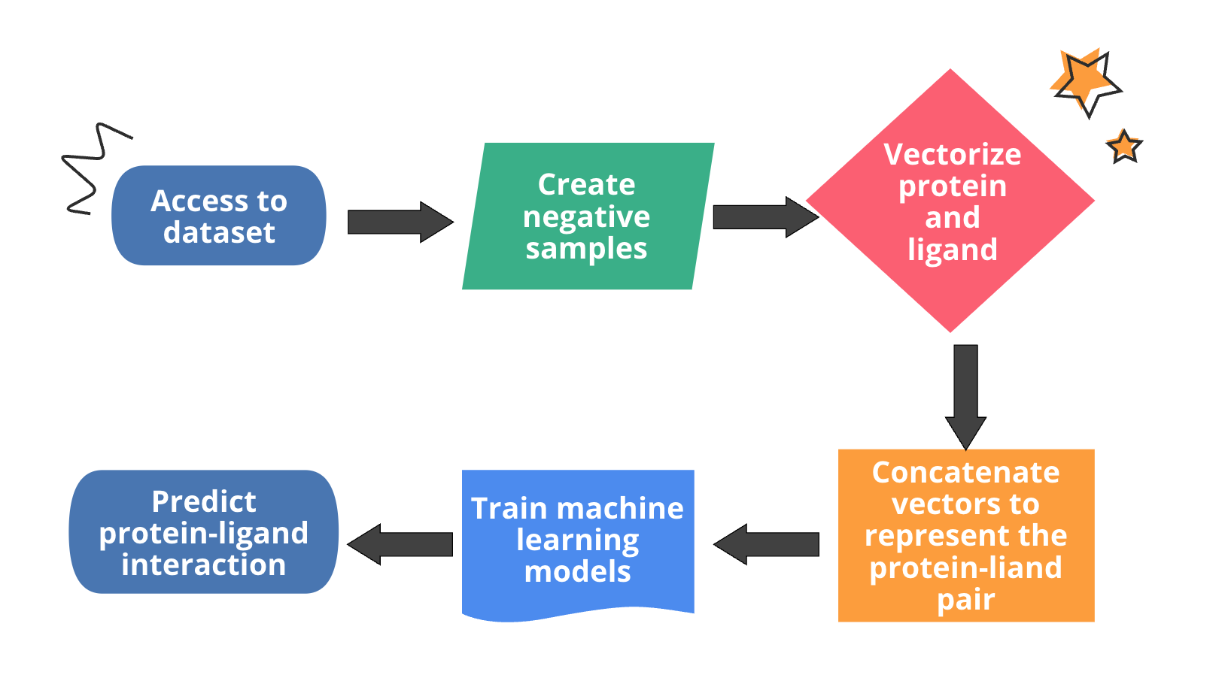
WorkFlow
Jiacheng Zu

Slide 6
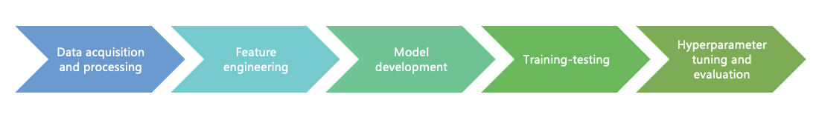
Application of ML Methods in Protein Ligand Prediction
Availability of high-resolution protein structure in various bases empowers the implementation of ML methods
ML can directly learn a parameterized function from a large amount of data integrating multiple sources of information, leading to better accuracy of predicting protein-ligand interactions
Basic workflow of existing ML methods to predict binding sites
Reference: SPVec: A Word2vec-Inspired Feature Representation Method for Drug-Target Interaction Prediction
Xinyi Guo & Shuangrui Chen
Notes:
With the growing availability of high-resolution protein structure in various databases, new possibilities for machine learning applications have been opened up. Machine learning can directly learn a parameterized function from a large amount of data integrating multiple sources of information, leading to better accuracy of predicting protein-ligand interaction.

Slide 7
Application of ML Methods in Protein Ligand Prediction
ML methods rely heavily on data representation (or features)
Feature extraction: tremendous manpower and expert insights
Representation learning (RL) is introduced for applying ML models
RL aims to automatically learn the representations
Word2vec: one of the most popular RL methods
ProtVec: the adaption of Word2vec to protein sequences
SMILES2Vec: introduces direct conversion of chemical structures from Simplified Molecular-Input Line-Entry System (SMILES) strings into vectors
SPVec: combinations of SMILES2Vec and ProtVec
Xinyi Guo & Shuangrui Chen
Notes:
Various machine learning methods have been developed in the last decades
Due to the complexity of protein structures, the performance of machine learning methods relies heavily on data representation (or features). Therefore, the design of data preprocessing and data transformation is of great concern to ensure that the data representation can support efficient machine learning algorithms. However, these feature extraction methods require tremendous manpower and expert insights.
Representation Learning aims to automatically learn the representations (or features) from raw data that can be effectively utilized by downstream machine learning models to improve the performance of the model. For example, Word2vec is one of the most popular RL methods. Word2vec has been adapted to protein sequences (ProtVec) for classification of protein families and prediction of disordered Proteins.
The SMILES2Vec is a model introduces a direct conversion of chemical structures from SMILES (Simplified Molecular-Input Line-Entry System) strings into vectors. These works show that RL technologies represented by Word2vec can automatically learn low-dimensional features from compound and protein feature space and achieve excellent performances.
SPVec vectors were constructed via the combination of SMILES2Vec and ProtVec to represent specific interactions. This method will be further explained by my teammate weifeng in his model explanation.

Slide 8
Problems Met
Path issue: Module Not Found Error, Incorrect Working Directory, etc.
Vector extraction requires too much memory
SystemExit: 2
ipykernel_launcher.py: error: unrecognized arguments
--f argument is typically used internally by Jupyter to specify a connection file; This file should be handled automatically by the Jupyter infrastructure.
Xinyi Guo & Shuangrui Chen
Notes:
drug-target interactions
This --f argument is typically used internally by Jupyter to specify a connection file. The file contains the necessary information to set up the communication with the Jupyter notebook interface. This file should not be provided manually; it's usually handled automatically by the Jupyter infrastructure.

Slide 9
Software and packages used
Python
Pandas, numpy, sklearn
train_test_split
TfidfVectorizer
SVC
accuracy_score, precision_score, recall_score, f1_score
LogisticRegression
RandomForestClassifier
Zhongzheng Mao

Slide 10
Data preprocessing
Generate negative samples
Since all the data have positive labels, we need to generate negative labels manually.
First create a dictionary containing protein-ligand pairs that are known to bind (positive samples).
Then create a negative sample by randomly selecting a protein-ligand pair not in the dictionary and adding their attributes to a new row in the data frame.
This process is repeated until the same number of negative samples as positive samples are generated (class-balanced dataset).
Zhongzheng Mao

Slide 11
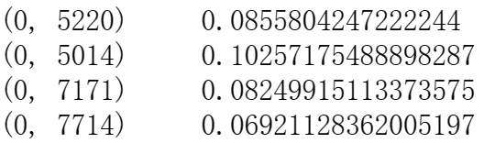
Data preprocessing
Seq
SMILES
TF-IDF is a common text feature representation method that considers the frequency of each word in a document (TF) and its rarity across the entire corpus (IDF). TfidfVectorizer
In this problem, we can treat protein sequences and SMILES strings as a special type of "text", where each amino acid or atom can be considered as a "word".
By setting analyzer='char' and ngram_range=(1, 3), we tell TfidfVectorizer to consider single characters, bigrams, and trigrams as features. This can capture some local pattern information.
TfidfVectorizer will transform the raw sequences and SMILES into numerical feature vectors, which can then be input into machine learning models.
Zhongzheng Mao

Slide 12
Model training and evaluation
 | Average accuracy | Average precision | Average recall | Average F1 score
SVM | 0.667 | 0.600 | 0.002 | 0.004
Logistic Regression | 0.659 | 0.075 | 0.002 | 0.004
Random Forest | 0.666 | 0.000 | 0.000 | 0.000
5-fold cross validation
Vector representation
TfidfVectorizer
Zhongzheng Mao

Slide 13
Hurdles
Model performance
Other four attributes: receptor_features, ligand_xyz, ligand_xyz_2d, ligand_bonds
feature vector: flatten, scaler, use the np.vstack function to vertically stack the processed feature vectors, forming a 2D array
presence of NaN values, inconsistent feature vector lengths across different samples, inconsistent shapes of the feature matrix, negative values in index
Elapsed time
Very time-consuming
Randomly sampled
Zhongzheng Mao

Slide 14
Software and packages used
Python
Pandas, numpy, sklearn, gensim, random, re, pickle, statistics
Word2Vec
SVC
LogisticRegression
RandomForestClassifier
MLPClassifier
KFold
accuracy_score, precision_score, recall_score, f1_score
Wei Feng Siew

Slide 15
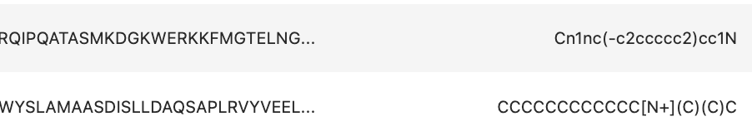
Data preprocessing
After generating negative samples, vectorize Seq and SMILES of protein-ligand pairs
Seq
100-vector
SPVec
SMILES
100-vector
SPVec: Treat every 3 consecutive characters as a token. Train Word2Vec model using the skip-gram approach (sg=1), negative sampling (negative = 5) and window_size =5.
Protein or ligand vector = average vector of all tokens in the Seq or SMILES
Protein-ligand pair vector= concatenate(protein vector, ligand vector)
Train machine learning model with protein-ligand pair vectors and corresponding labels (binding / non-binding)
Wei Feng Siew

Slide 16
Model training and evaluation
 | Average accuracy | Average precision | Average recall | Average F1 score
SVM | 0.570 | 0.562 | 0.637 | 0.596
Logistic Regression | 0.479 | 0.480 | 0.490 | 0.484
Random Forest | 0.556 | 0.553 | 0.597 | 0.573
Multilayer Perceptron | 0.586 | 0.583 | 0.609 | 0.595
5-fold cross validation
Data points (ligand-protein pairs)
16000
Positive labels (binding pairs)
8000
Negative labels (non-binding pairs)
8000
Vector representation
SPVec
Wei Feng Siew

Slide 17
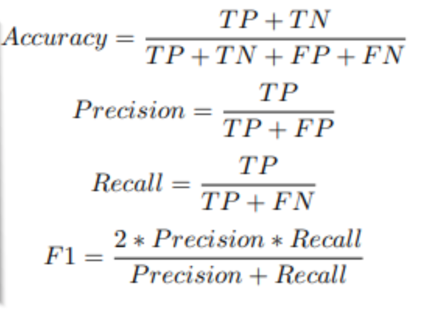
Comparison (5-fold cross validated results)
 | Average accuracy | Average precision | Average recall | Average F1 score
SVM | 0.667 | 0.600 | 0.002 | 0.004
Logistic Regression | 0.659 | 0.075 | 0.002 | 0.004
Random Forest | 0.666 | 0.000 | 0.000 | 0.000
 | Average accuracy | Average precision | Average recall | Average F1 score
SVM | 0.570 | 0.562 | 0.637 | 0.596
Logistic Regression | 0.479 | 0.480 | 0.490 | 0.484
Random Forest | 0.556 | 0.553 | 0.597 | 0.573
Multilayer Perceptron | 0.586 | 0.583 | 0.609 | 0.595
Vector representation: TfidfVectorizer
Vector representation: SPVec

Slide 18
Hurdles
Attempted to devise an original method of creating vector representations of Seqs and SMILES, but using them to fit the machine learning model resulted in poor performance. Resolved challenge by using SPVec vector representations with a proven track record.
Many data points and hence a long time required to fit machine learning models and perform 5-fold cross validation.
Wei Feng Siew

Slide 19
Discussion & Conclusion
Having meaningful vector representation is really important.
There was a lack of negative samples for training machine learning models.
RL methods are advantageous in both efficiency and effectiveness.
Xinyi Guo & Shuangrui Chen
Notes:
Vector representation is really important. If we don’t have meaningful vector representations, it’s difficult to train a decent model. And coming up with meaningful vector representation would probably require interdisciplinary collaboration between people with an understanding of statistics and people having deep domain knowledge in chemistry.
There was a lack of negative samples for training machine learning models. Scientists should pay more attention to negative samples and add them to databases. Although we created negative samples, we are not sure if they are truly negative samples, because there are no experimental results showing that the protein-ligand pair does not bind.
To ensure the performance of a machine learning model, a large number of data points was required. RL methods can be integrated to learn low-dimensional features from compound and protein feature space to improve model performances. This suggests its advantages in both efficiency and effectiveness.
It appears that ML-based prediction methods can reach a higher level of accuracy if we incorporate the use of a large number of physicochemical properties and implement state-of-the-art deep learning techniques.

Slide 20
Group 12 Contribution Table
Name | Presentation Contribution | Report Contribution
Jiacheng Zu | Introduction, Data, Workflow | Abstract, Introduction, Format Editor
Zhongzheng Mao | Methods, Results | Methods, Results, Discussion
Wei Feng Siew | Methods, Results | Methods, Results
Xinyi Guo | Literature Review, Discussion | Literature Review, Discussion
Shuangrui Chen | Literature Review, Discussion | Literature Review, Discussion
All of us contributed equally to the project in various roles.
Sign: Jiacheng Zu, Zhongzheng Mao, Wei Feng Siew, Xinyi Guo, Shuangrui Chen

